Slide 1
Artificial Neural Networks and AI
Artificial Neural Networks provide…
A new computing paradigm
A technique for developing trainable classifiers, memories, dimension-reducing mappings, etc
A tool to study brain function

Slide 2
Converging Frameworks
Artificial intelligence (AI): build a
“packet of intelligence” into a machine
Cognitive psychology: explain human behavior by interacting processes (schemas) “in the head” but not localized in the brain
Brain Theory: interactions of components of the brain -
- computational neuroscience
- neurologically constrained-models
and abstracting from them as both Artificial intelligence and Cognitive psychology:
- connectionism: networks of trainable “quasi-neurons” to provide “parallel distributed models” little constrained by neurophysiology
- abstract (computer program or control system) information processing models

Slide 3

Vision, AI and ANNs
1940s: beginning of Artificial Neural Networks
 McCullogh & Pitts, 1942
Σ_{i} w_{i}x_{i} ≥ θ
Perceptron learning rule (Rosenblatt, 1962)
Backpropagation
Hopfield networks (1982)
Kohonen self-organizing maps
…

Slide 4
Vision, AI and ANNs
1950s: beginning of computer vision
Aim: give to machines same or better vision capability as ours
Drive: AI, robotics applications and factory automation
Initially: passive, feedforward, layered and hierarchical process
that was just going to provide input to higher reasoning
processes (from AI)
But soon: realized that could not handle real images
1980s: Active vision: make the system more robust by allowing the
vision to adapt with the ongoing recognition/interpretation

Slide 5
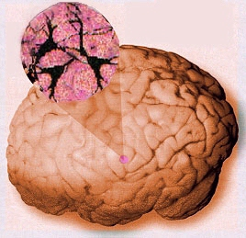

Slide 6
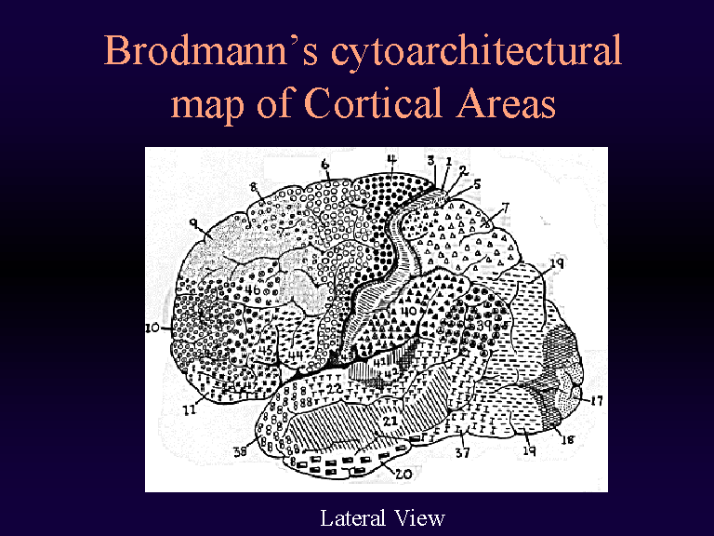

Slide 7
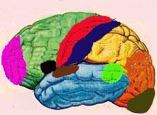
Major Functional Areas
Primary motor: voluntary movement
Primary somatosensory: tactile, pain, pressure, position, temp., mvt.
Motor association: coordination of complex movements
Sensory association: processing of multisensorial information
Prefrontal: planning, emotion, judgement
Speech center (Broca’s area): speech production and articulation
Wernicke’s area: comprehen-
sion of speech
Auditory: hearing
Auditory association: complex
auditory processing
Visual: low-level vision
Visual association: higher-level
vision

Slide 8
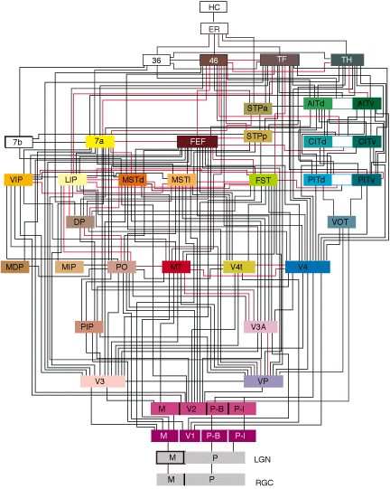
Interconnect
Felleman & Van Essen, 1991

Slide 9
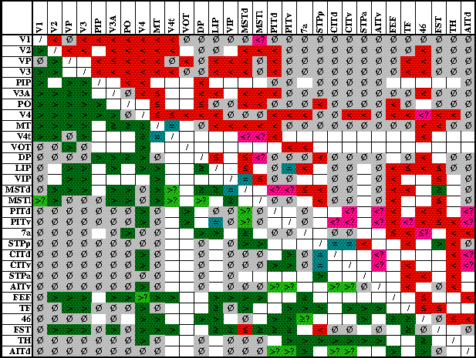
More on Connectivity

Slide 10
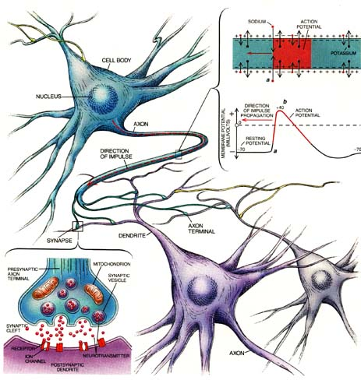
Neurons and Synapses

Slide 11
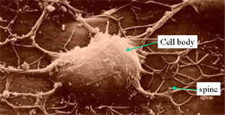
Electron Micrograph of a Real Neuron

Slide 12
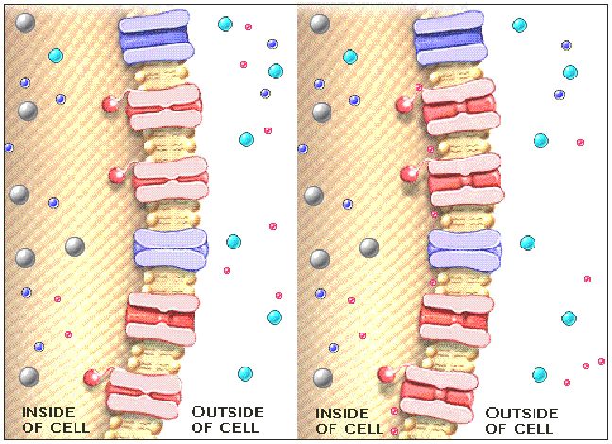
Transmenbrane Ionic Transport
Ion channels act as gates that allow or block the flow of specific ions into and out of the cell.

Slide 13
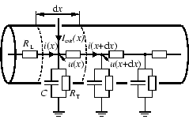
The Cable Equation
See
http://diwww.epfl.ch/~gerstner/SPNM/SPNM.html
for excellent additional material (some reproduced here).
Just a piece of passive dendrite can yield complicated differential equations which have been extensively studied by electronicians in the context of the study of coaxial cables (TV antenna cable):

Slide 14
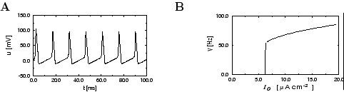
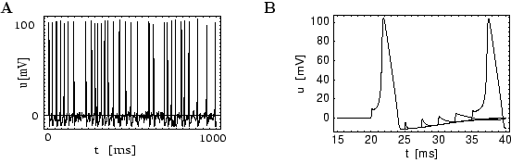
The Hodgkin-Huxley Model
Example spike trains obtained…

Slide 15
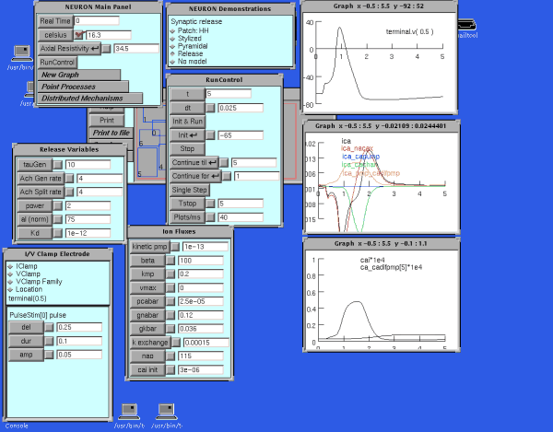
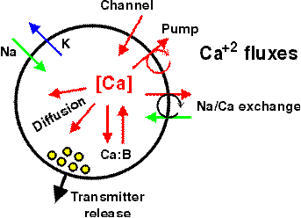
Detailed Neural Modeling
A simulator, called “Neuron” has been developed
at Yale to simulate the Hodgkin-Huxley equations,
as well as other membranes/channels/etc.
See http://www.neuron.yale.edu/

Slide 16
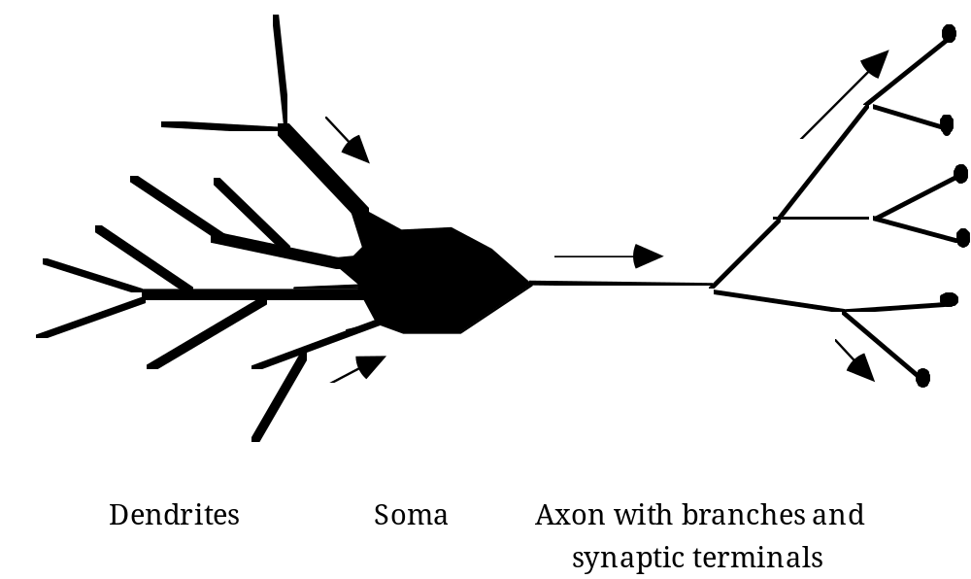
The "basic" biological neuron
The soma and dendrites act as the input surface; the axon carries the outputs.
The tips of the branches of the axon form synapses upon other neurons or upon effectors (though synapses may occur along the branches of an axon as well as the ends). The arrows indicate the direction of "typical" information flow from inputs to outputs.

Slide 17
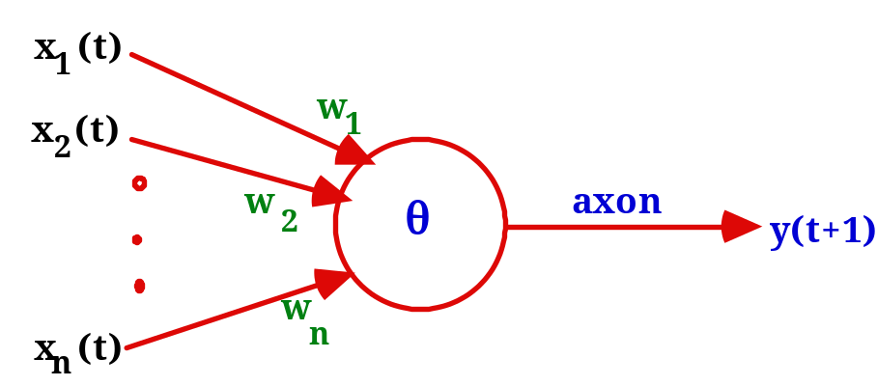
Warren McCulloch and Walter Pitts (1943)
A McCulloch-Pitts neuron operates on a discrete
time-scale, t = 0,1,2,3, ... with time tick equal to
one refractory period
At each time step, an input or output is
on or off — 1 or 0, respectively.
Each connection or synapse from the output of one neuron to the input of another, has an attached weight.

Slide 18
Excitatory and Inhibitory Synapses
We call a synapse
excitatory if w_{i} > 0, and
inhibitory if w_{i} < 0.
We also associate a threshold θ with each neuron
A neuron fires (i.e., has value 1 on its output line) at time t+1 if the weighted sum of inputs at t reaches or passes θ:
y(t+1) = 1 if and only if Σ w_{i}x_{i}(t) ≥ θ

Slide 19
From Logical Neurons to Finite Automata
1
Brains, Machines, and
AND
1.5
Mathematics, 2nd Edition,
1987
1
Boolean Net
1
→
X Y
OR
0.5
1
NOT
X
0
Finite
-1
Automaton
Y
Q

Slide 20
Increasing the Realism of Neuron Models
The McCulloch-Pitts neuron of 1943 is important
as a basis for
logical analysis of the neurally computable, and
current design of some neural devices (especially when augmented by learning rules to adjust synaptic weights).
However, it is no longer considered a useful model for making contact with neurophysiological data concerning real neurons.

Slide 21
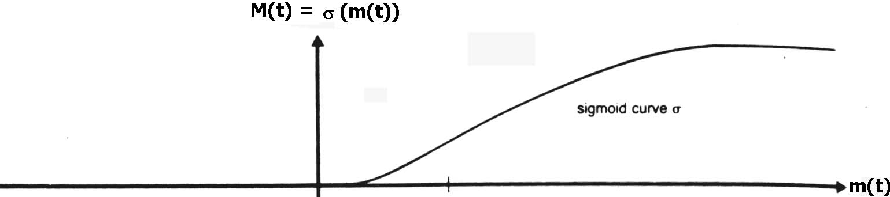
Leaky Integrator Neuron
The simplest "realistic" neuron model is a
continuous time model based on using the firing rate (e.g., the number of spikes traversing the axon in the most recent 20 msec.) as a continuously varying measure of the cell's activity
The state of the neuron is described by a single variable, the membrane potential.
The firing rate is approximated by a sigmoid, function of membrane potential.

Slide 22
Leaky Integrator Model
m(t)
τ = - m(t) + h
has solution m(t) = e^{-t/τ} m(0) + (1 - e^{-t/τ})h
→ h for time constant τ > 0.
We now add synaptic inputs to get the
Leaky Integrator Model:
τ = - m(t) + Σ _{i} w_{i} X_{i}(t) + h
where X_{i}(t) is the firing rate at the i^{th} input.
Excitatory input (w_{i} > 0) will increase
Inhibitory input (w_{i} < 0) will have the opposite effect.
m(t)
m(t)

Slide 23
Hopfield Networks
A paper by John Hopfield in 1982 was the catalyst
in attracting the attention of many physicists to
"Neural Networks".
In a network of McCulloch-Pitts neurons
whose output is 1 iff Σwij sj ≥ θ_{i} and is otherwise 0,
neurons are updated synchronously: every neuron processes its inputs at each time step to determine a new output.

Slide 24
Hopfield Networks
A Hopfield net (Hopfield 1982) is a net of such units subject to the asynchronous rule for updating one neuron at a time:
"Pick a unit i at random.
If Σwij sj ≥ θ_{i}, turn it on.
  Otherwise turn it off."
Moreover, Hopfield assumes symmetric weights:
wij = wji

Slide 25
“Energy” of a Neural Network
Hopfield defined the “energy”:
E = - ½ Σ _{ij} s_{i}s_{j}w_{ij} + Σ _{i} s_{i}θ_{i}
If we pick unit i and the firing rule (previous slide) does not change its s_{i}, it will not change E.

Slide 26
si: 0 to 1 transition
If s_{i} initially equals 0, and Σ w_{ij}s_{j} ≥ θ_{i}
then s_{i} goes from 0 to 1 with all other s_{j} constant,
and the "energy gap", or change in E, is given by
ΔE = - ½ Σ_{j} (w_{ij}s_{j} + w_{ji}s_{j}) + θ_{i}
= - (Σ _{j} w_{ij}s_{j} - θ_{i}) (by symmetry)
≤ 0.

Slide 27
si: 1 to 0 transition
If s_{i} initially equals 1, and Σ w_{ij}s_{j} < θ_{i}
then s_{i} goes from 1 to 0 with all other s_{j} constant
The "energy gap," or change in E, is given, for symmetric w_{ij}, by:
ΔE = Σ_{j} w_{ij}s_{j} - θ_{i} < 0
On every updating we have ΔE ≤ 0

Slide 28
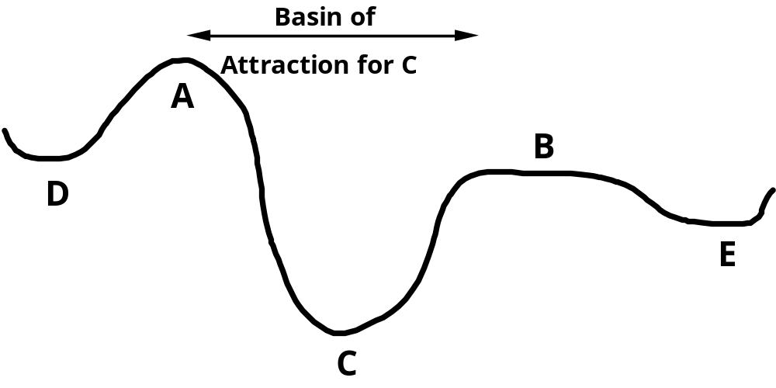
Minimizing Energy
On every updating we have ΔE ≤ 0
Hence the dynamics of the net tends to move E toward a minimum.
We stress that there may be different such states — they are local minima. Global minimization is not guaranteed.

Slide 29
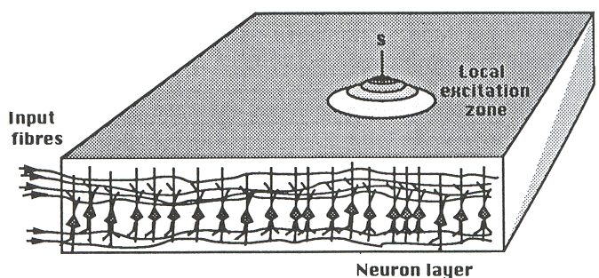
Self-Organizing Feature Maps
The neural sheet is
represented in a discretized
form by a (usually) 2-D
lattice A of formal neurons.
The input pattern is a vector x from some pattern space V. Input vectors are normalized to unit length.
The responsiveness of a neuron at a site r in A is measured by x.wr = Σi xi wri
where wr is the vector of the neuron's synaptic efficacies.
The "image" of an external event is regarded as the unit with the maximal response to it

Slide 30
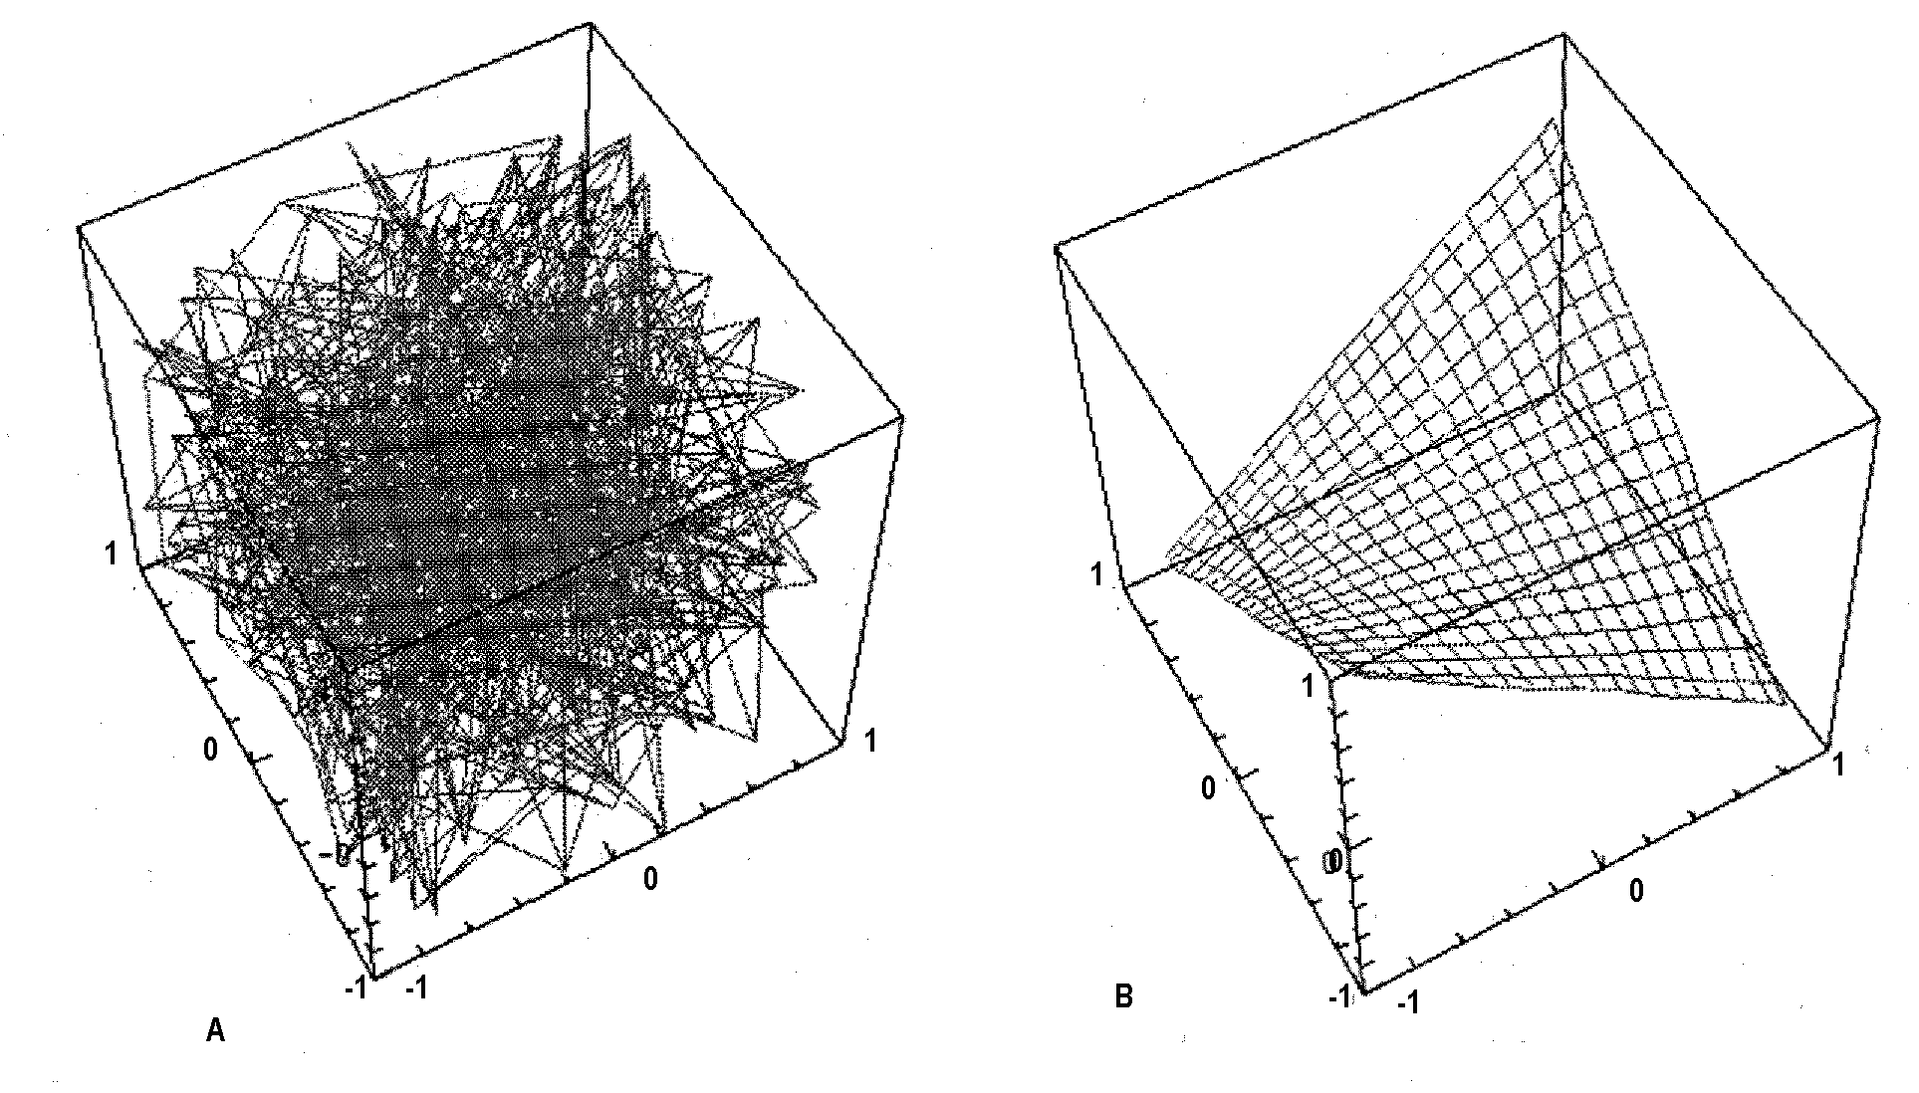
Self-Organizing Feature Maps
Typical graphical representation: plot the weights (wr) as vertices and draw links between neurons that are nearest neighbors in A.

Slide 31
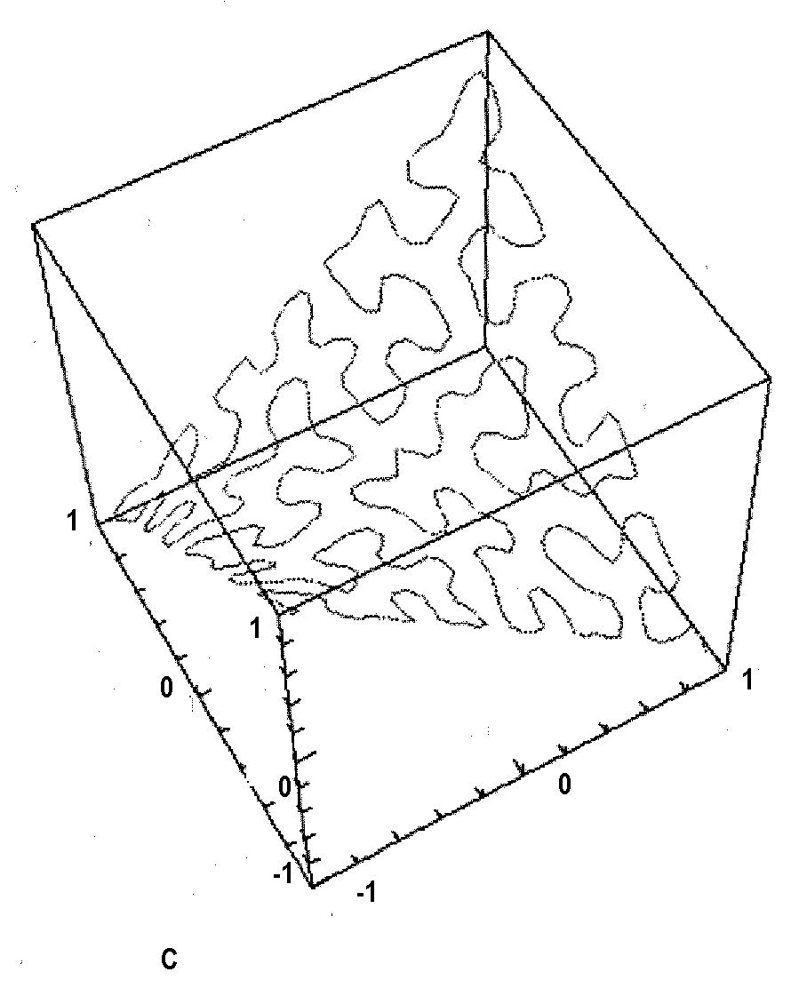
Self-Organizing Feature Maps
These maps are typically useful to achieve some dimensionality-reducing mapping between inputs and outputs.

Slide 32
Applications: Classification
Business
  Credit rating and risk assessment
  Insurance risk evaluation
  Fraud detection
  Insider dealing detection
  Marketing analysis
  Mailshot profiling
  Signature verification
  Inventory control
Security
  Face recognition
  Speaker verification
  Fingerprint analysis
Medicine
  General diagnosis
  Detection of heart defects
Engineering
  Machinery defect diagnosis
  Signal processing
  Character recognition
  Process supervision
  Process fault analysis
  Speech recognition
  Machine vision
  Speech recognition
  Radar signal classification
Science
  Recognising genes
  Botanical classification
  Bacteria identification

Slide 33
Applications: Modeling
Business
  Prediction of share and commodity prices
  Prediction of economic indicators
  Insider dealing detection
  Marketing analysis
  Mail stop profiling
  Signature verification
  Inventory control
Engineering
  Transducer linearization
  Color discrimination
  Robot control and navigation
  Process control
  Aircraft landing control
  Car active suspension control
  Printed Circuit auto routing
  Integrated circuit layout
  Image compression
Science
  Prediction of the performance of drugs from the molecular structure
  Weather prediction
  Sunspot prediction
Medicine
  . Medical imaging and image processing

Slide 34
Applications: Forecasting
  Future sales
  Production Requirements
  Market Performance
  Economic Indicators
  Energy Requirements
  Time Based Variables

Slide 35
Applications: Novelty Detection
  Fault Monitoring
  Performance Monitoring
  Fraud Detection
  Detecting Rate Features
  Different Cases

Slide 36
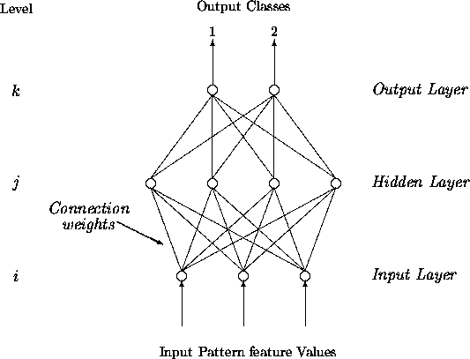
Multi-layer Perceptron Classifier

Slide 37
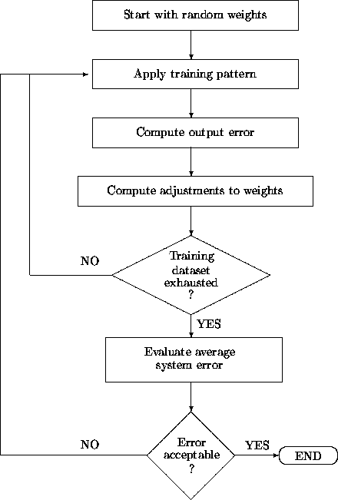
Multi-layer Perceptron
Classifier
http://ams.egeo.sai.jrc.it/eurostat/Lot16-SUPCOM95/node7.html

Slide 38
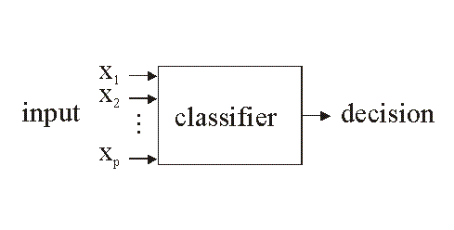
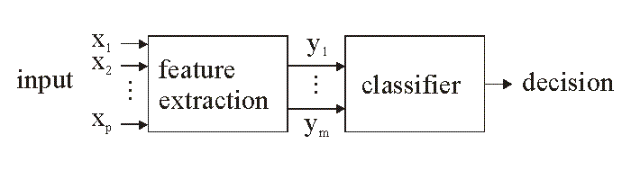
Classifiers
1-stage approach
2-stage
approach

Slide 39
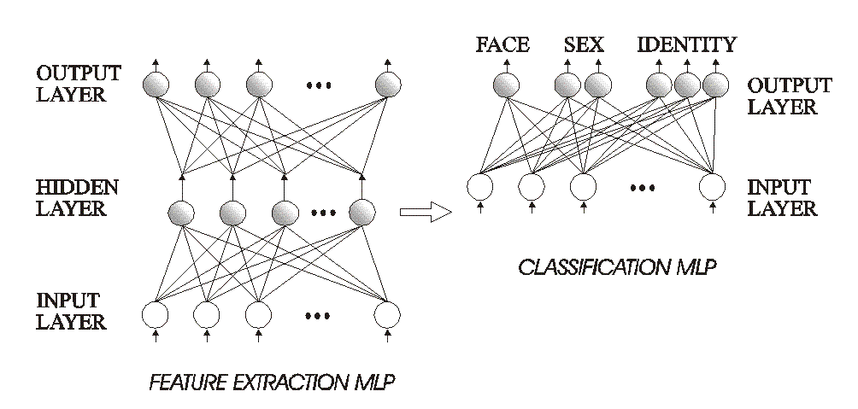
Example: face recognition
Here using the 2-stage approach:

Slide 40
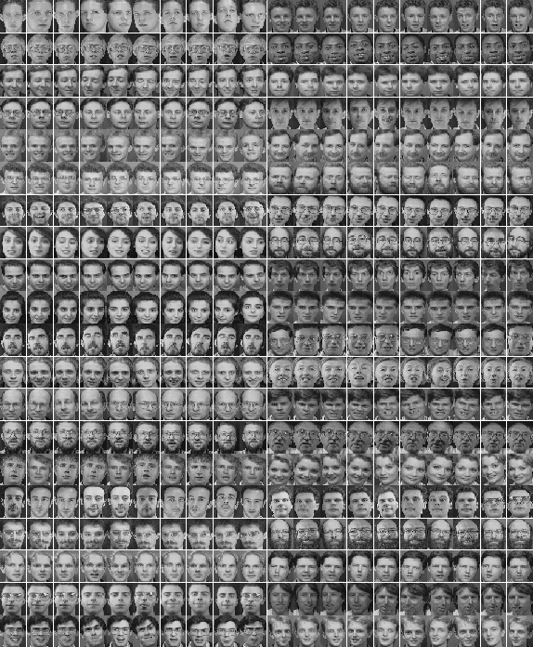
Training

Slide 41
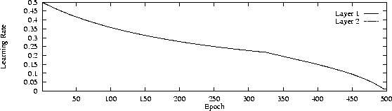
Learning rate

Slide 42
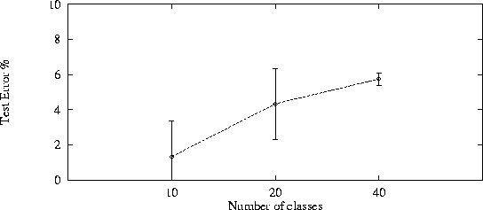
Testing / Evaluation
Look at performance as a function of network complexity

Slide 43
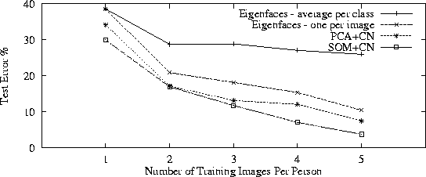
Testing / Evaluation
Comparison with other known techniques

Slide 44
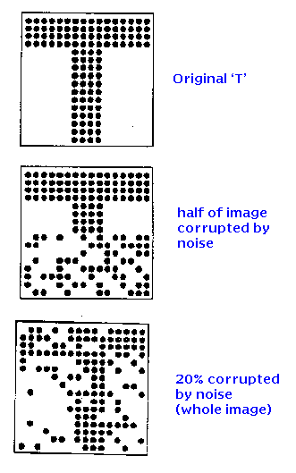
Associative Memories
Idea: store:
So that we can recover it if presented
with corrupted data such as:

Slide 45
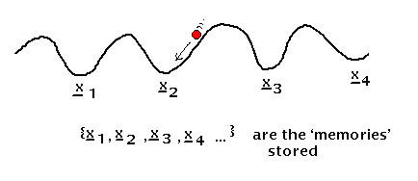
Associative memory with Hopfield nets
Setup a Hopfield net such that local minima correspond
to the stored patterns.
Issues:
- because of weight symmetry, anti-patterns (binary reverse) are stored as well as the original patterns (also spurious local minima are created when many patterns are stored)
- if one tries to store more than about 0.14*(number of neurons) patterns, the network exhibits unstable behavior
- works well only if patterns are uncorrelated

Slide 46
Capabilities and Limitations of Layered Networks
Issues:
what can given networks do?
What can they learn to do?
How many layers required for given task?
How many units per layer?
When will a network generalize?
What do we mean by generalize?
…

Slide 47
Capabilities and Limitations of Layered Networks
What about Boolean functions?
Single-layer perceptrons are very limited:
- XOR problem
- etc.
But what about multilayer perceptrons?
We can represent any Boolean function with a network with just one hidden layer.
How??

Slide 48
Capabilities and Limitations of Layered Networks
To approximate a set of functions of the inputs by a layered network with continuous-valued units and sigmoidal activation function…
Cybenko, 1988: … at most two hidden layers are necessary, with arbitrary accuracy attainable by adding more hidden units.
Cybenko, 1989: one hidden layer is enough to approximate any continuous function.
Intuition of proof: decompose function to be approximated into a sum of localized “bumps.” The bumps can be constructed with two hidden layers.
Similar in spirit to Fourier decomposition. Bumps = radial basis functions.

Slide 49
Optimal Network Architectures
How can we determine the number of hidden units?
genetic algorithms: evaluate variations of the network, using a metric that combines its performance and its complexity. Then apply various mutations to the network (change number of hidden units) until the best one is found.
Pruning and weight decay:
- apply weight decay (remember reinforcement learning) during training
- eliminate connections with weight below threshold
- re-train
- How about eliminating units? For example, eliminate units with total synaptic input weight smaller than threshold.

Slide 50
For further information
See
Hertz, Krogh & Palmer: Introduction to the theory of neural computation (Addison Wesley)
In particular, the end of chapters 2 and 6.

